Slide 1
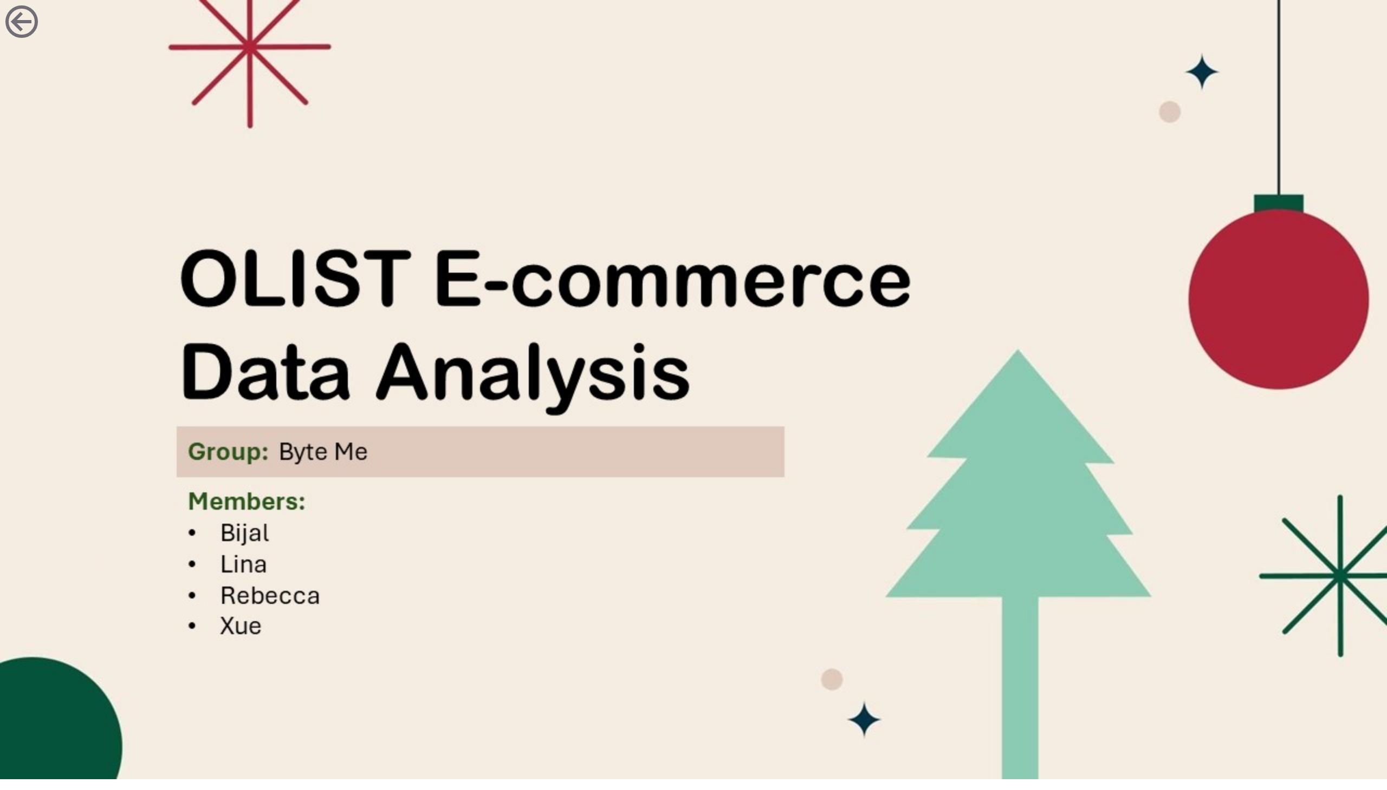
Introduct
Notes:
image
No alt text provided
actionButton
No alt text provided

Slide 2
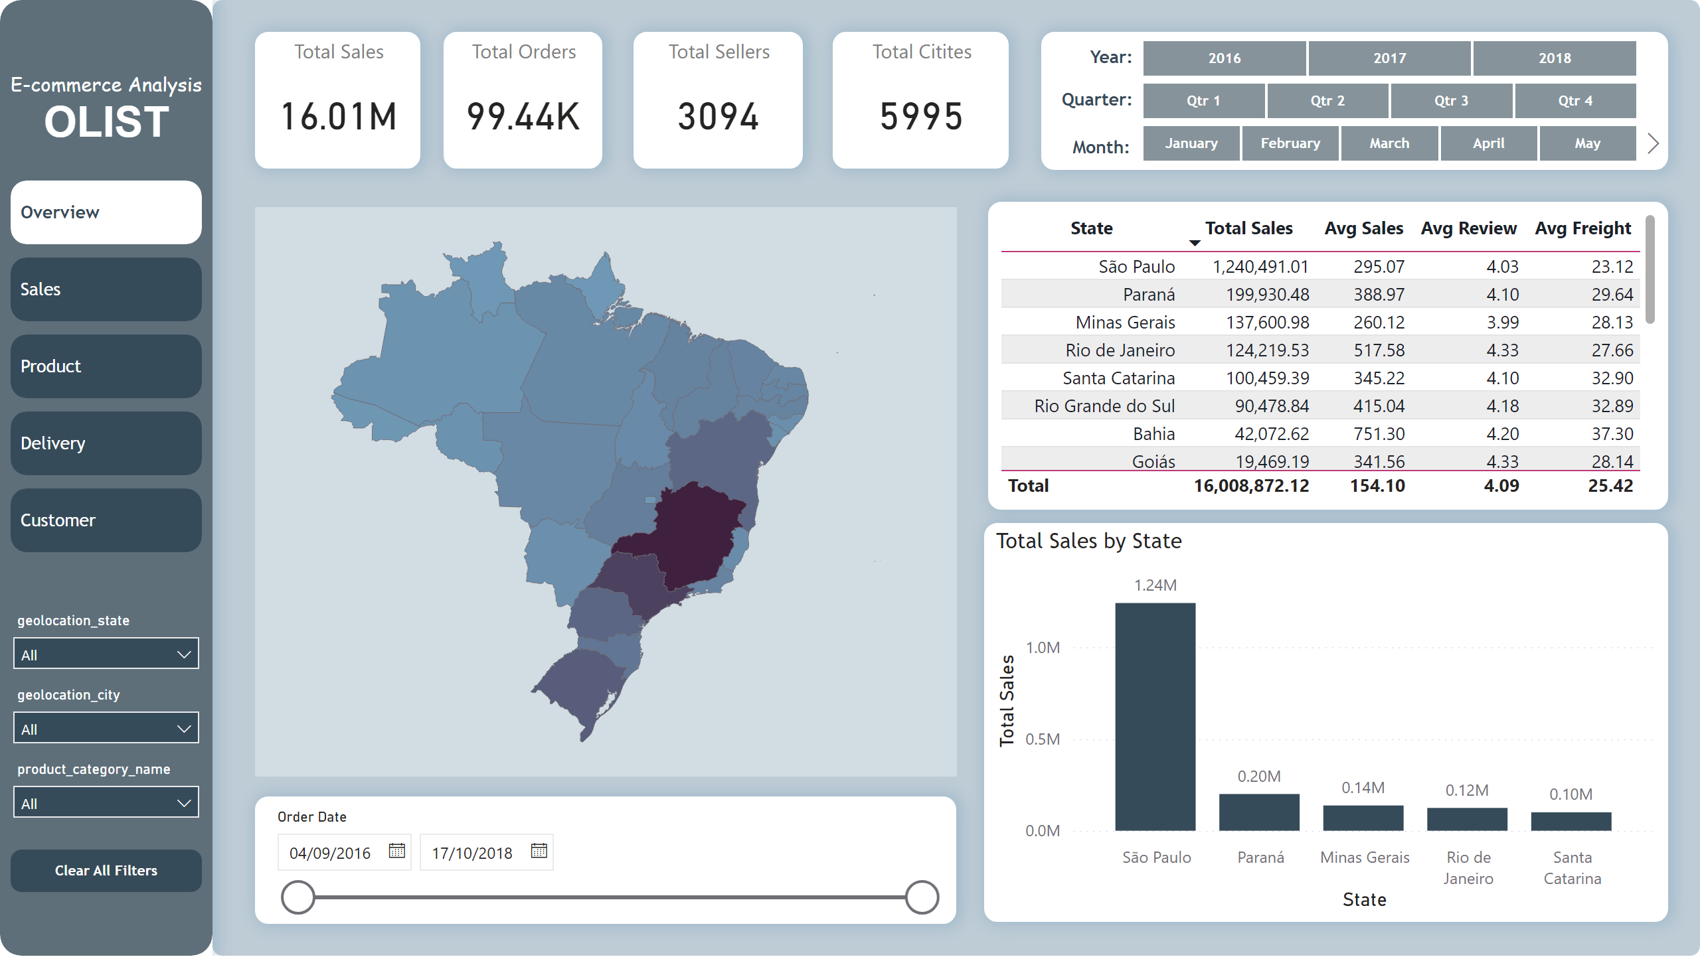
Overview
Notes:
shape
No alt text provided
textbox
No alt text provided
textbox
No alt text provided
textbox
No alt text provided
slicer
No alt text provided
slicer
No alt text provided
slicer
No alt text provided
shape
No alt text provided
Total Sales
No alt text provided
Total Orders
No alt text provided
tableEx
No alt text provided
Total Sellers
No alt text provided
Total Citites
No alt text provided
clusteredColumnChart
No alt text provided
slicer
No alt text provided
shapeMap
No alt text provided
TITLE
No alt text provided
Overview
No alt text provided
Customer
No alt text provided
Sales
No alt text provided
Product
No alt text provided
Delivery
No alt text provided
Slicer1
No alt text provided
Slicer2
No alt text provided
Slicer3
No alt text provided
Clear all filters
No alt text provided
shape
No alt text provided
actionButton
No alt text provided

Slide 3
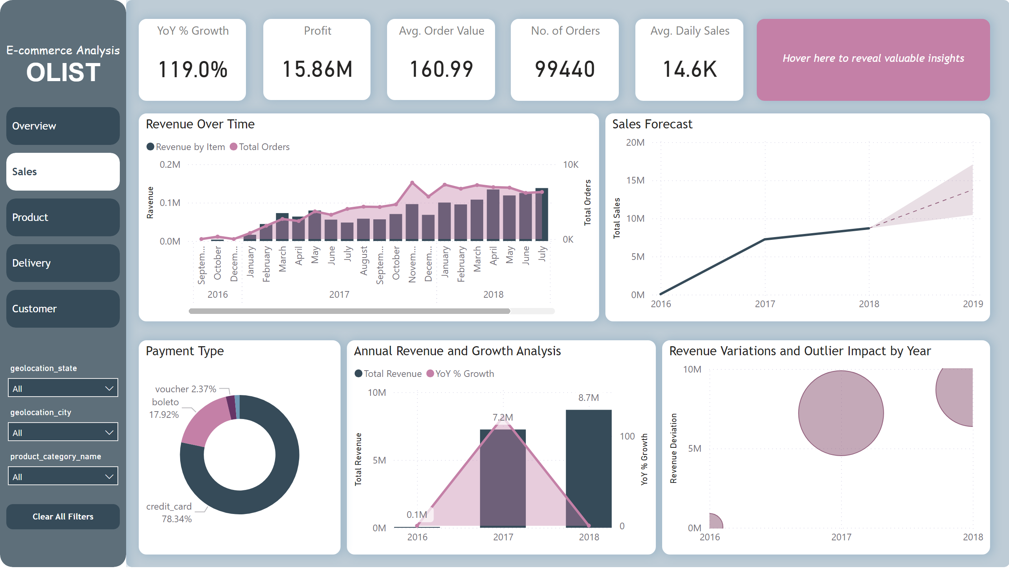
Sales: Revenue Over Time
Notes:
shape
No alt text provided
Profit
No alt text provided
Avg. Order Value
No alt text provided
Revenue Over Time
No alt text provided
No. of Orders
No alt text provided
Avg. Daily Sales
No alt text provided
Annual Revenue and Growth Analysis
No alt text provided
YoY % Growth
No alt text provided
Sales Forecast
No alt text provided
Revenue Variations and Outlier Impact by Year
No alt text provided
Payment Type
No alt text provided
Insight card
No alt text provided
TITLE
No alt text provided
Overview
No alt text provided
Customer
No alt text provided
Sales
No alt text provided
Product
No alt text provided
Delivery
No alt text provided
Slicer1
No alt text provided
Slicer2
No alt text provided
Slicer3
No alt text provided
Clear all filters
No alt text provided
shape
No alt text provided

Slide 4
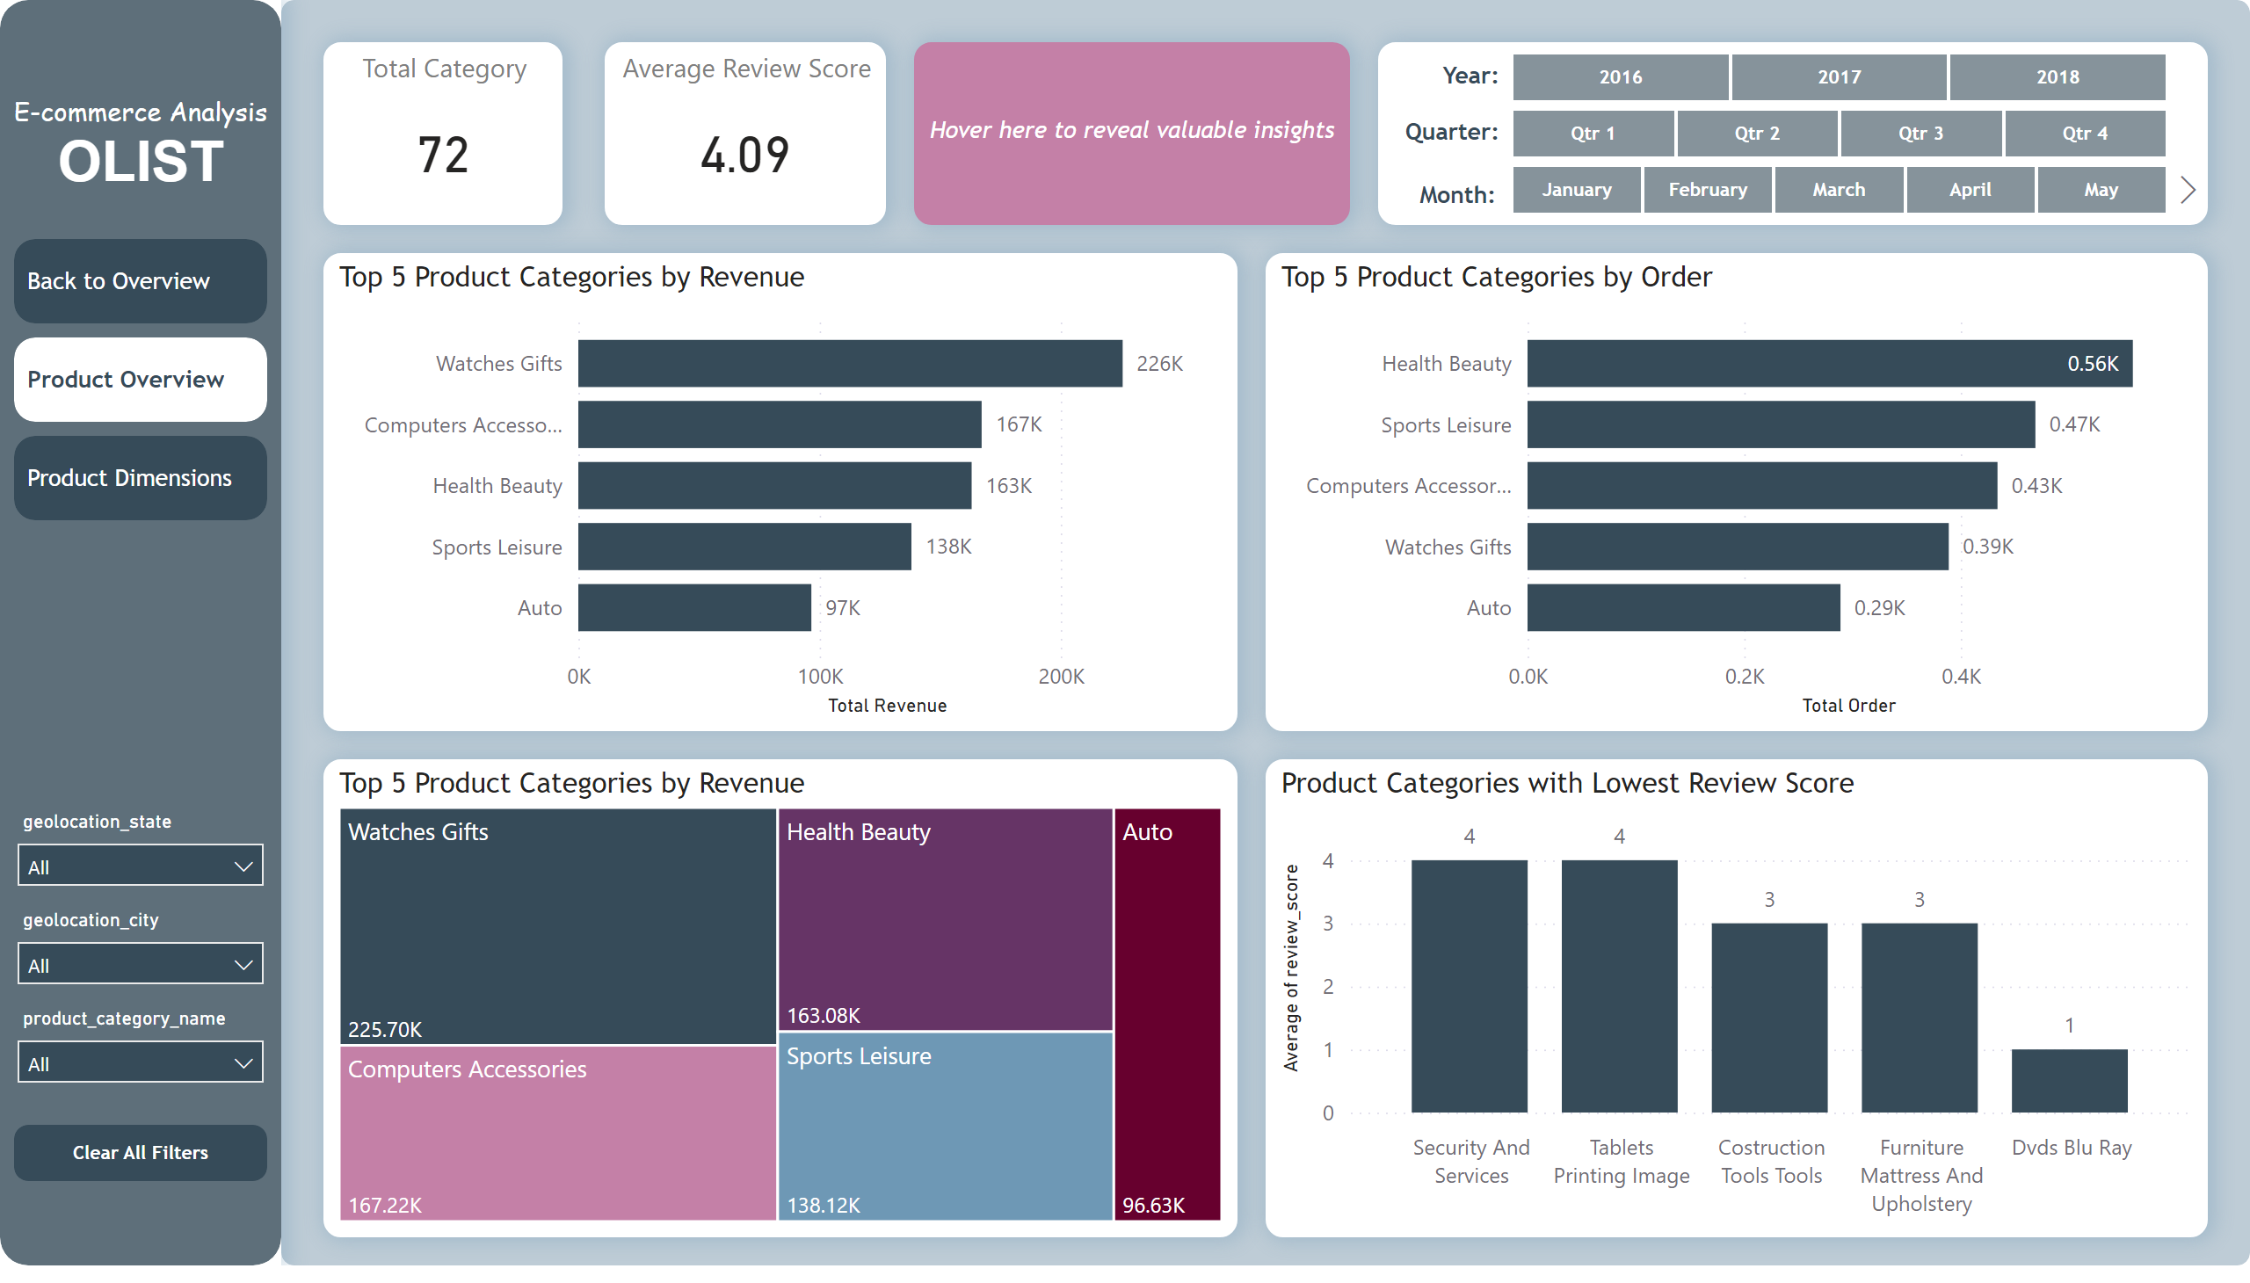
Product Overview
Notes:
Insight card
No alt text provided
shape
No alt text provided
TITLE
No alt text provided
Overview
No alt text provided
Customer
No alt text provided
Sales
No alt text provided
Slicer1
No alt text provided
Slicer2
No alt text provided
Slicer3
No alt text provided
Clear all filters
No alt text provided
shape
No alt text provided
Top 5 Product Categories by Revenue
No alt text provided
Top 5 Product Categories by Order
No alt text provided
Product Categories with Lowest Review Score
No alt text provided
Top 5 Product Categories by Revenue
No alt text provided
Total Category
No alt text provided
textbox
No alt text provided
textbox
No alt text provided
textbox
No alt text provided
slicer
No alt text provided
slicer
No alt text provided
slicer
No alt text provided
shape
No alt text provided
Average Review Score
No alt text provided

Slide 5
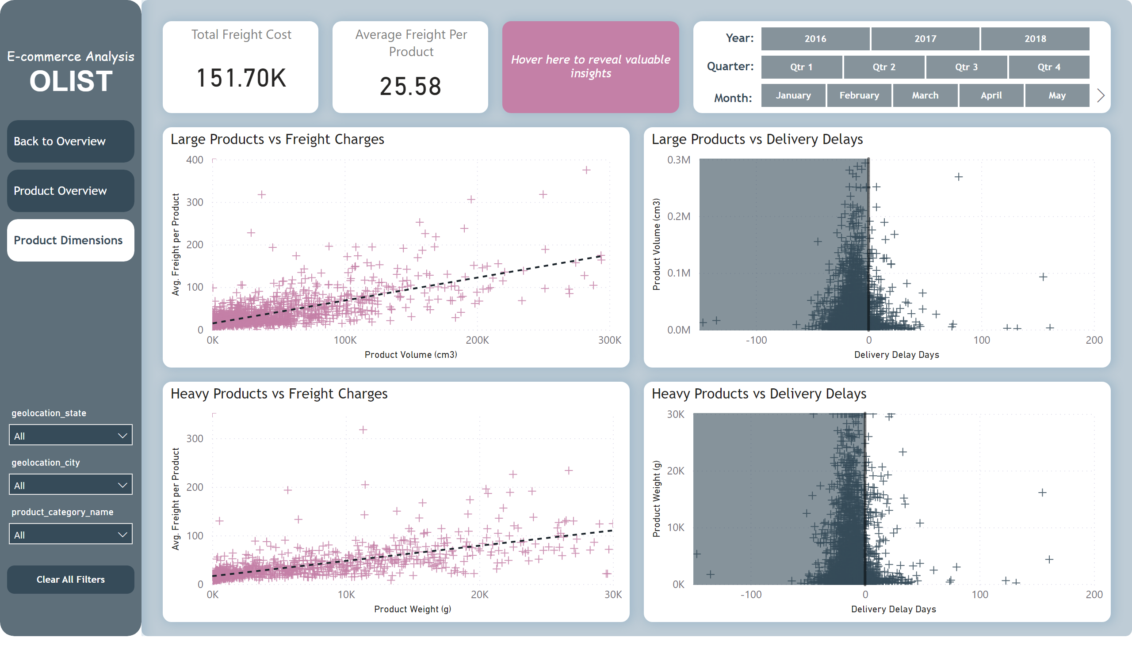
Product Dimensions
Notes:
Large Products vs Freight Charges
No alt text provided
Heavy Products vs Freight Charges
No alt text provided
Heavy Products vs Delivery Delays
No alt text provided
Large Products vs Delivery Delays
No alt text provided
Insight card
No alt text provided
shape
No alt text provided
Total Freight Cost
No alt text provided
Average Freight Per Product
No alt text provided
textbox
No alt text provided
textbox
No alt text provided
textbox
No alt text provided
slicer
No alt text provided
slicer
No alt text provided
slicer
No alt text provided
shape
No alt text provided
TITLE
No alt text provided
Overview
No alt text provided
Customer
No alt text provided
Sales
No alt text provided
Slicer1
No alt text provided
Slicer2
No alt text provided
Slicer3
No alt text provided
Clear all filters
No alt text provided
shape
No alt text provided

Slide 6
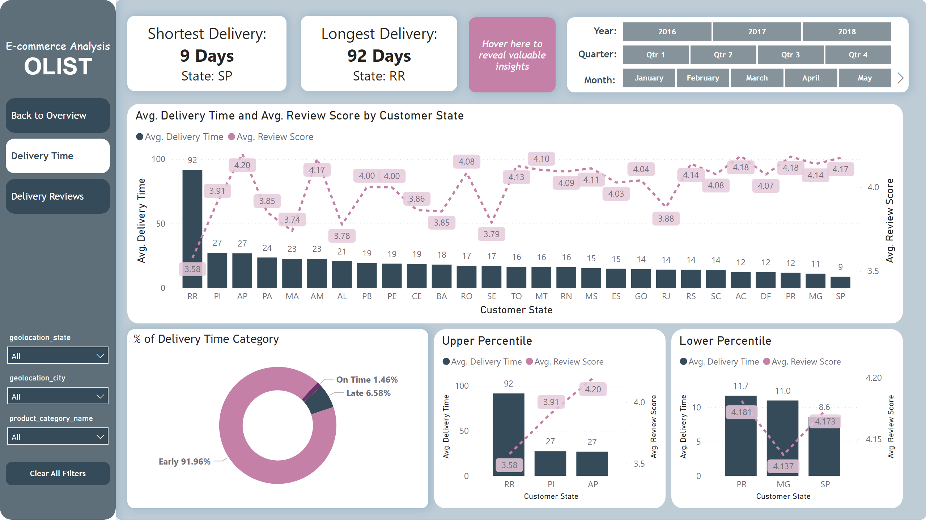
Delivery Time
Notes:
Insight card
No alt text provided
textbox
No alt text provided
textbox
No alt text provided
shape
No alt text provided
TITLE
No alt text provided
Overview
No alt text provided
Customer
No alt text provided
Sales
No alt text provided
Slicer1
No alt text provided
Slicer2
No alt text provided
Slicer3
No alt text provided
Clear all filters
No alt text provided
shape
No alt text provided
textbox
No alt text provided
textbox
No alt text provided
textbox
No alt text provided
slicer
No alt text provided
slicer
No alt text provided
slicer
No alt text provided
shape
No alt text provided
Lower Percentile
No alt text provided
Upper Percentile
No alt text provided
% of Delivery Time Category
No alt text provided
lineStackedColumnComboChart
No alt text provided

Slide 7
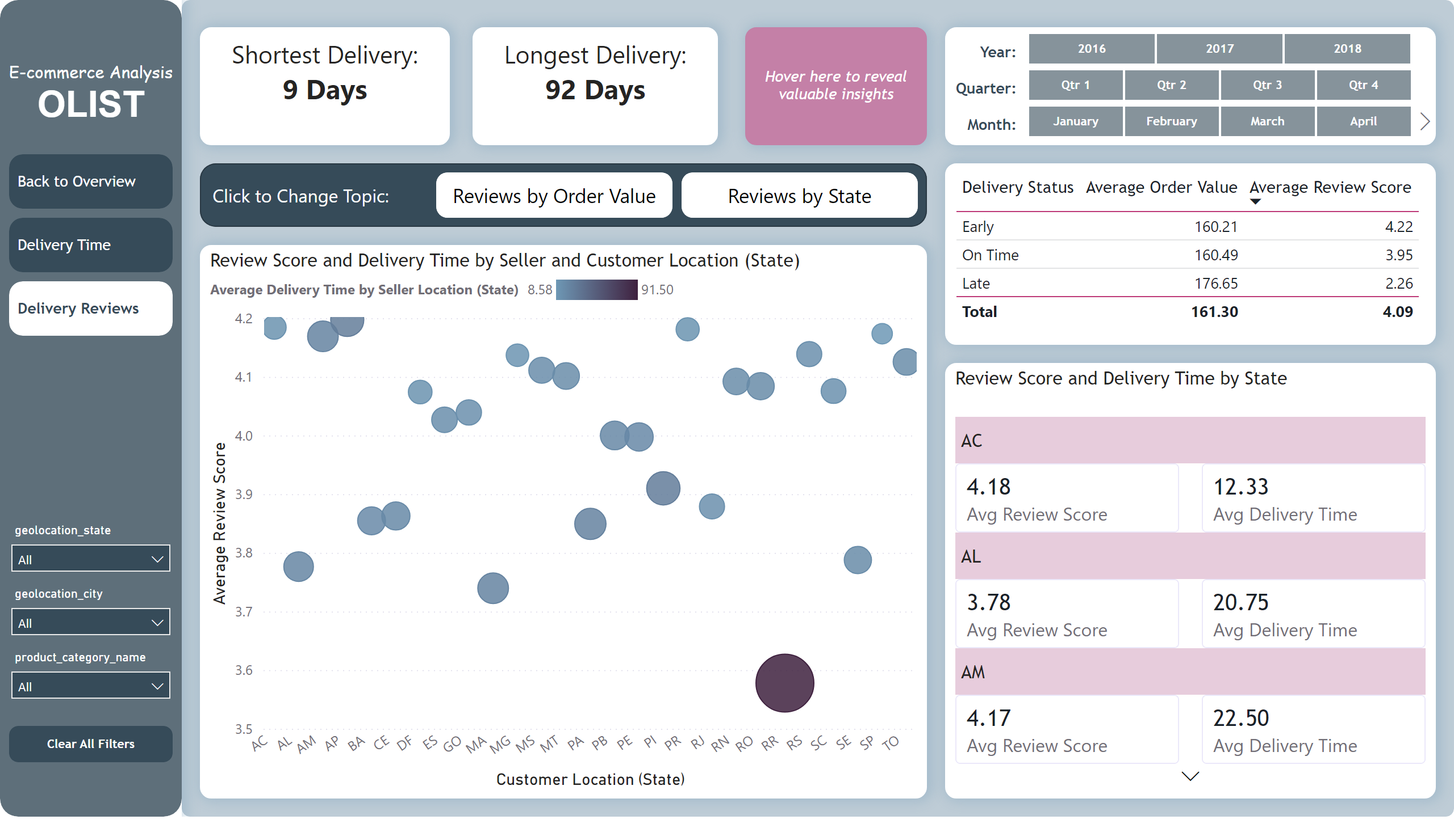
Delivery Reviews
Notes:
shape
No alt text provided
TITLE
No alt text provided
Overview
No alt text provided
Customer
No alt text provided
Sales
No alt text provided
Slicer1
No alt text provided
Slicer2
No alt text provided
Slicer3
No alt text provided
Clear all filters
No alt text provided
shape
No alt text provided
card
No alt text provided
textbox
No alt text provided
textbox
No alt text provided
cardVisual
No alt text provided
lineChart
No alt text provided
textbox
No alt text provided
textbox
No alt text provided
textbox
No alt text provided
slicer
No alt text provided
slicer
No alt text provided
slicer
No alt text provided
shape
No alt text provided
actionButton
No alt text provided
actionButton
No alt text provided
shape
No alt text provided
tableEx
No alt text provided
Review Score and Delivery Time by State
No alt text provided
Review Score and Delivery Time by Seller and Customer Location (State)
No alt text provided
tableEx
No alt text provided
textbox
No alt text provided
textbox
No alt text provided
Insight card
No alt text provided
Review Scores Button
No alt text provided
Review State Button
No alt text provided
shape
No alt text provided
textbox
No alt text provided
textbox
No alt text provided
textbox
No alt text provided
slicer
No alt text provided
slicer
No alt text provided
slicer
No alt text provided
shape
No alt text provided
shape
No alt text provided

Slide 8
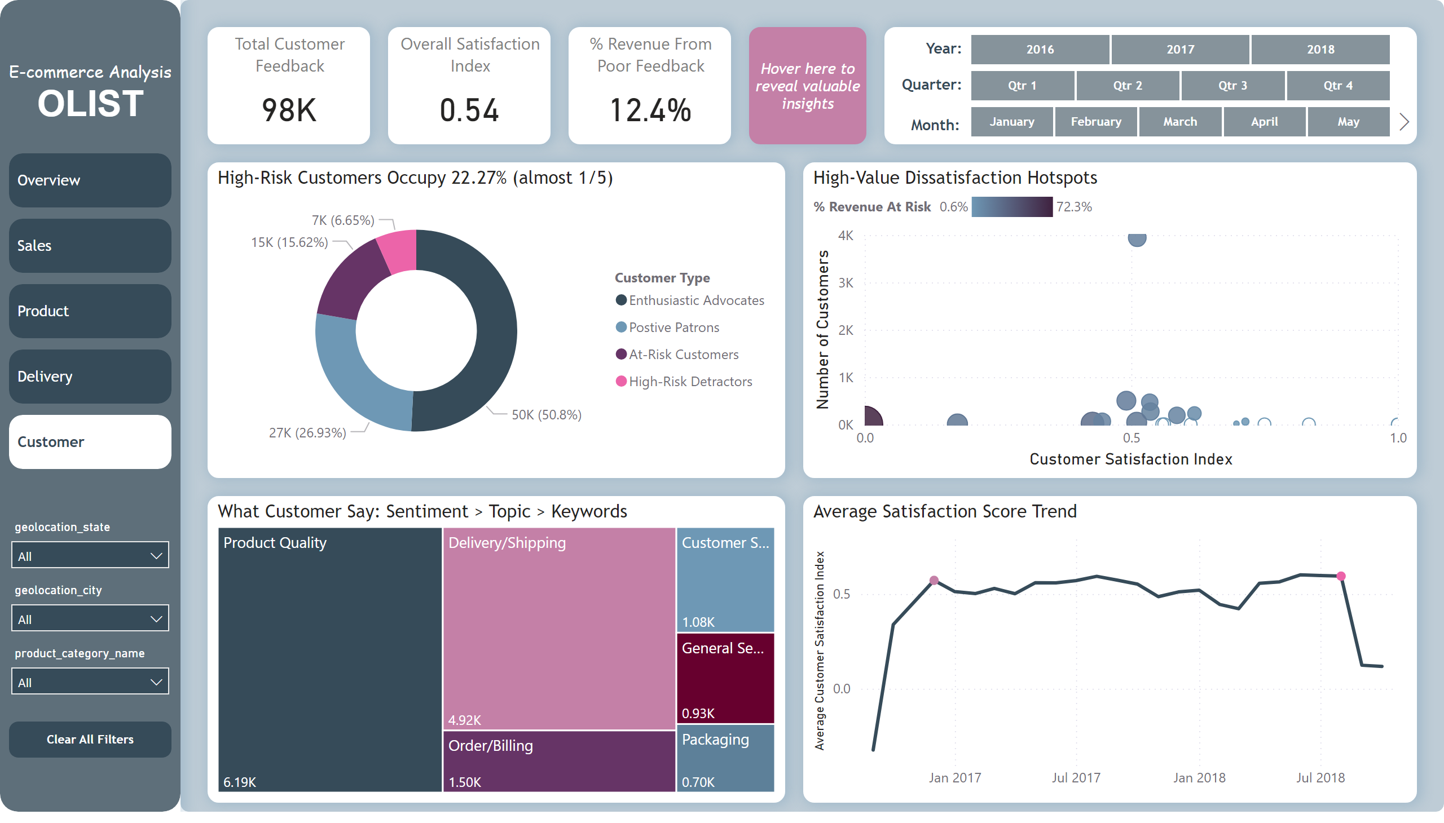
Customer
Notes:
Average Satisfaction Score Trend
No alt text provided
What Customer Say: Sentiment > Topic > Keywords
No alt text provided
High-Risk Customers Occupy 22.27% (almost 1/5)
No alt text provided
High-Value Dissatisfaction Hotspots
No alt text provided
Total Customer Feedback
No alt text provided
Overall Satisfaction Index
No alt text provided
% Revenue From Poor Feedback
No alt text provided
Insight card
No alt text provided
shape
No alt text provided
textbox
No alt text provided
textbox
No alt text provided
textbox
No alt text provided
slicer
No alt text provided
slicer
No alt text provided
slicer
No alt text provided
shape
No alt text provided
TITLE
No alt text provided
Overview
No alt text provided
Customer
No alt text provided
Sales
No alt text provided
Product
No alt text provided
Delivery
No alt text provided
Slicer1
No alt text provided
Slicer2
No alt text provided
Slicer3
No alt text provided
Clear all filters
No alt text provided
shape
No alt text provided

Slide 9
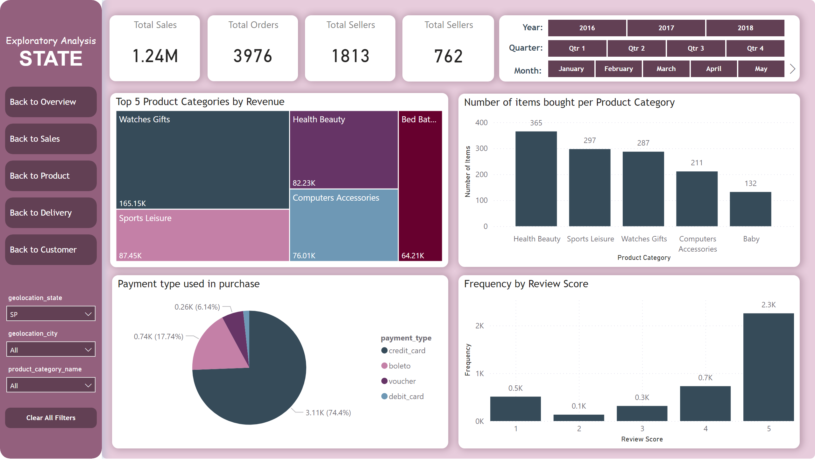
State Overview
Notes:
TITLE
No alt text provided
Slicer1
No alt text provided
Slicer2
No alt text provided
Slicer3
No alt text provided
Clear all filters
No alt text provided
shape
No alt text provided
Total Sales
No alt text provided
Total Orders
No alt text provided
Total Sellers
No alt text provided
Total Sellers
No alt text provided
Number of items bought per Product Category
No alt text provided
clusteredColumnChart
No alt text provided
Top 5 Product Categories by Revenue
No alt text provided
Payment type used in purchase
No alt text provided
shape
No alt text provided
textbox
No alt text provided
textbox
No alt text provided
textbox
No alt text provided
slicer
No alt text provided
slicer
No alt text provided
slicer
No alt text provided
shape
No alt text provided
Customer
No alt text provided
Delivery
No alt text provided
Product
No alt text provided
Sales
No alt text provided
Overview
No alt text provided

Slide 10
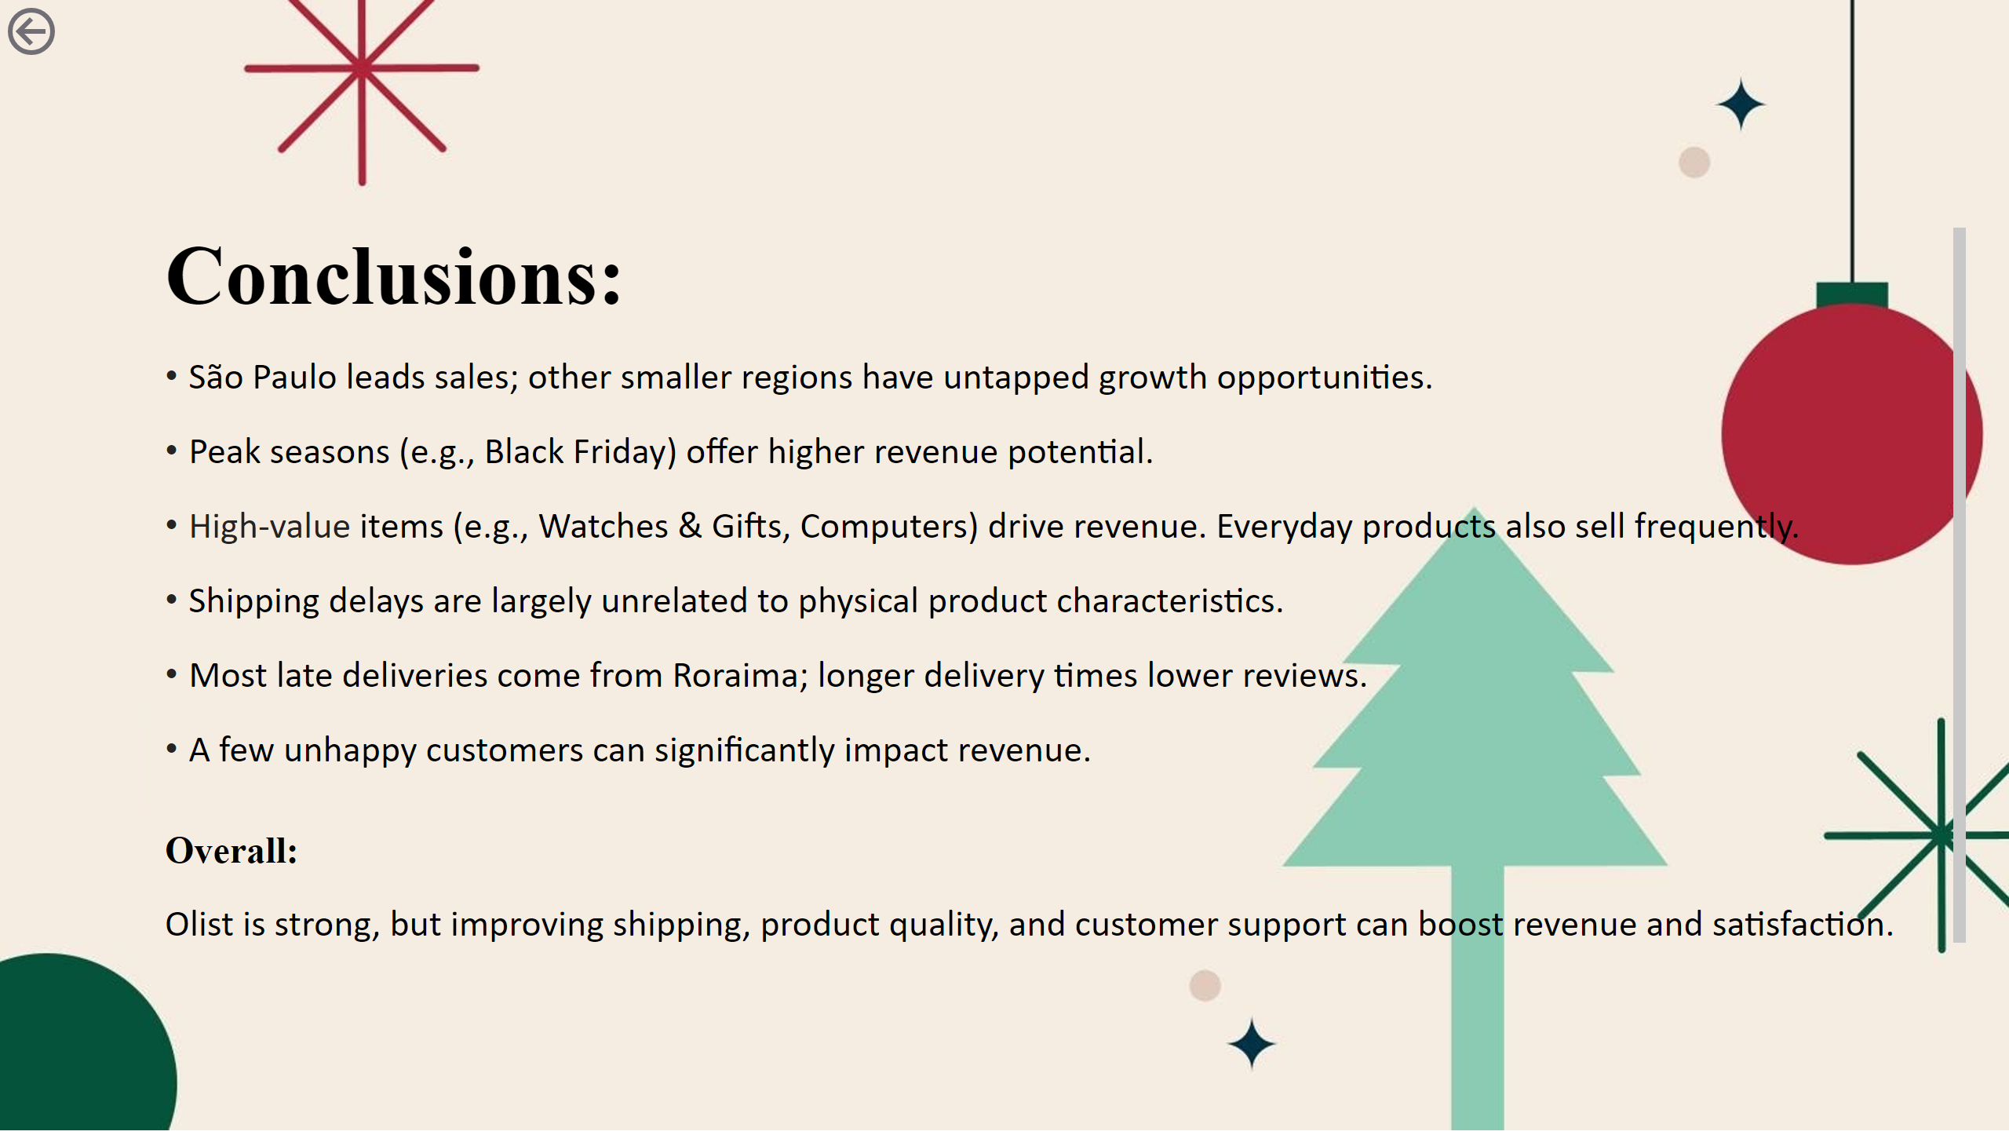
Conclusion
Notes:
image
No alt text provided
textbox
No alt text provided
actionButton
No alt text provided

